Slide 1
RNA-Seq Data Analysis 1
Lauren Vanderlinden
BIOS 6660
Spring 2019

Slide 2
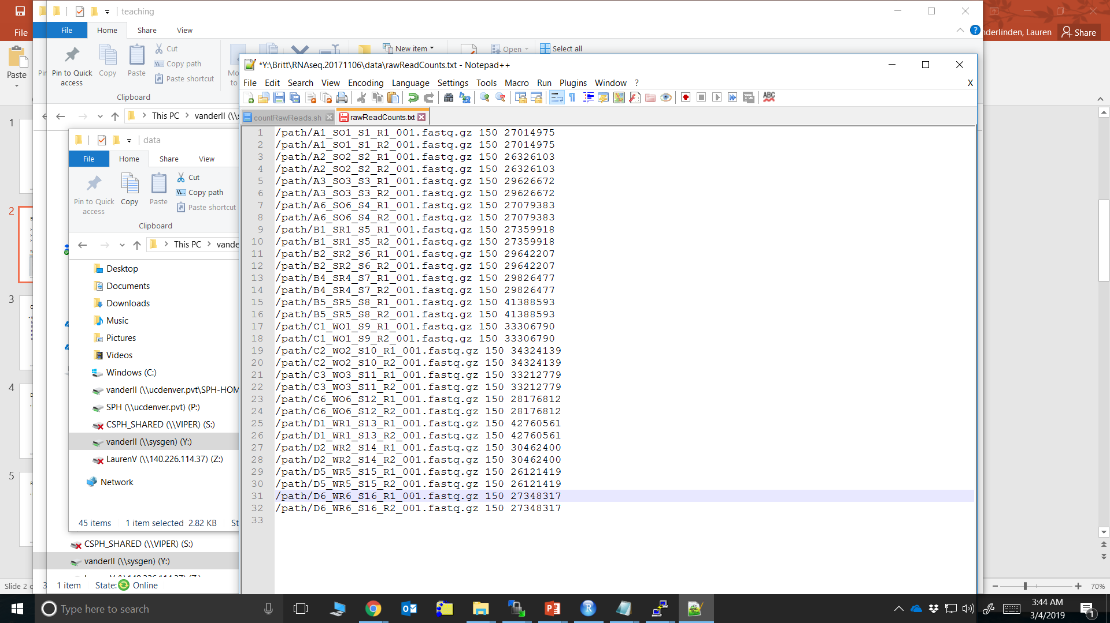
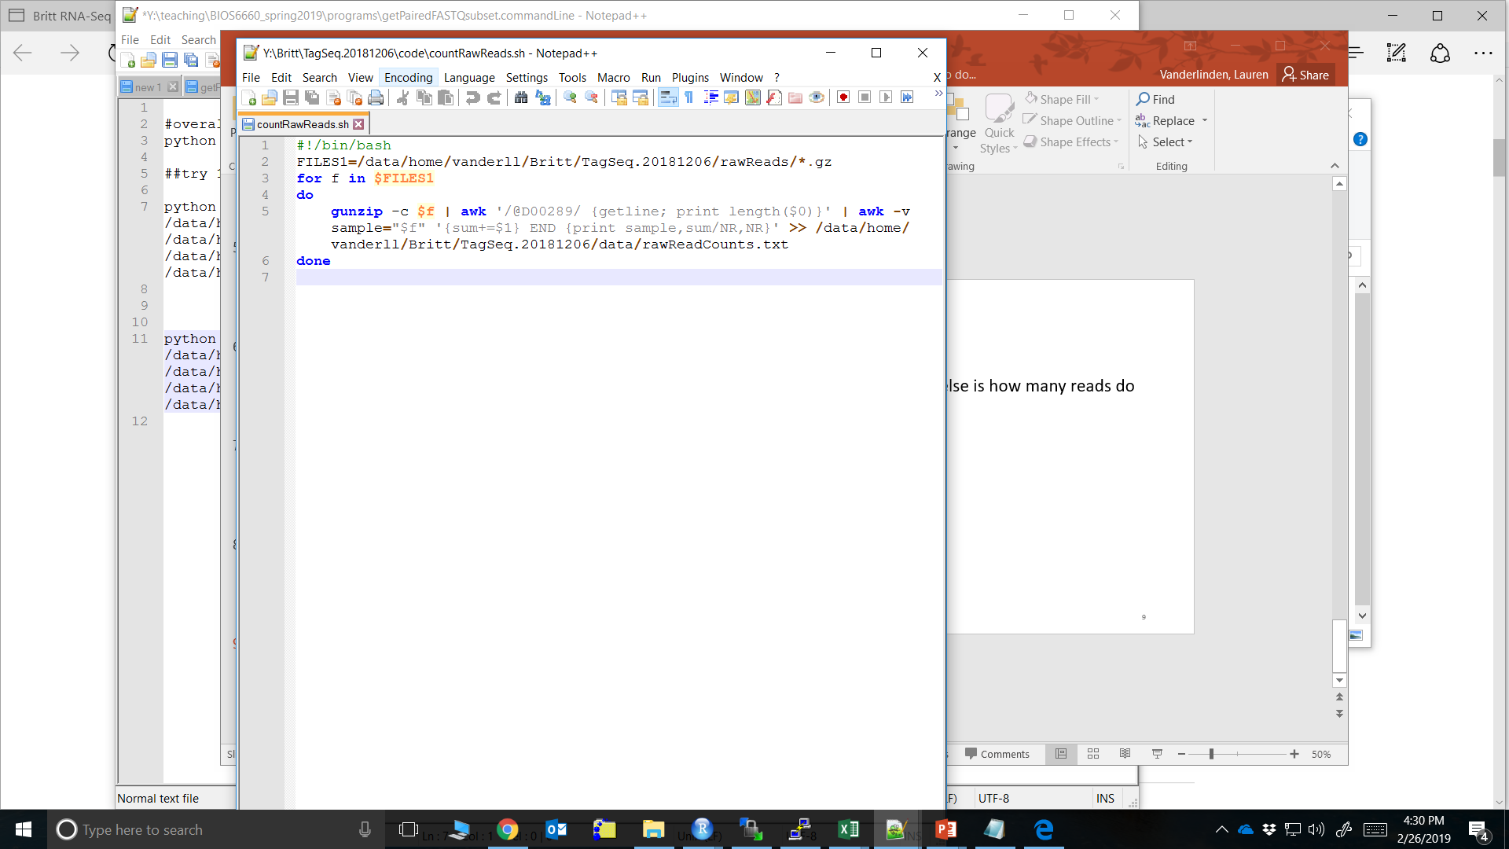
BASH Scripts from Last Time
> cd /home/teststudent/hw6Test/code
> chmod -R u+wrx *
> ./countRawReads.sh
Yampa: /BIOS6660/Homework6/exampleProgramsAndReports

Slide 3
Overview From Last Time
Raw Reads
Trim Reads
Optional: Transcriptome Reconstruction
Quantitate
Genome Alignment
We went from raw RNA-Seq reads to a nice matrix of counts
Rows = genes
Columns = samples
Now all the work we will do is in R!

Slide 4
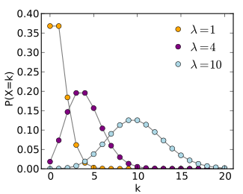
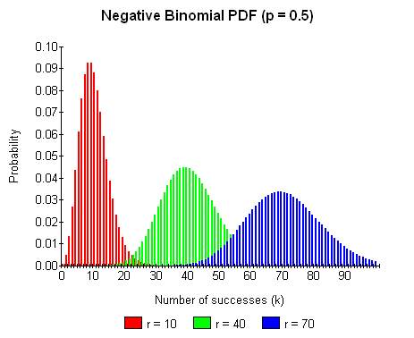
What Type of Data Do We Have?
Poisson PDF
We have a matrix of counts
Poisson
Assuming mean = variance
1 parameter (λ) (Figure k = # occurrences)
Negative Binomial
Does not make mean = variance assumption
2 parameters:
r is the total # successes
p is the probability of success of a single trial
Source: wikipedia
Source: systomath

Slide 5
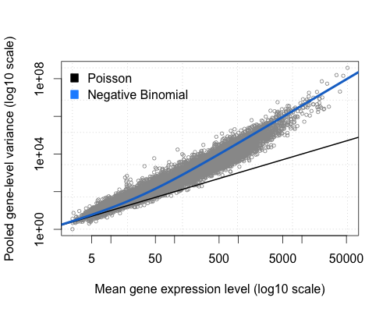
Negative Binomial
Variance of counts is generally greater than their mean, especially for genes expressed at a higher level.
This is called overdispersion
1/r is also sometimes called the “dispersion” or “shape” parameter
Negative Binomial current choice
Source: RECount Project

Slide 6
Exploring Data Through Visualization
Normally, plot your data in a histogram and see what it looks like.
This is not so easy with any ‘Omics data as you have large number of features (~20,000 genes)
Next few slides I’m going to walk through some visualizations I look at when analyzing a dataset

Slide 7
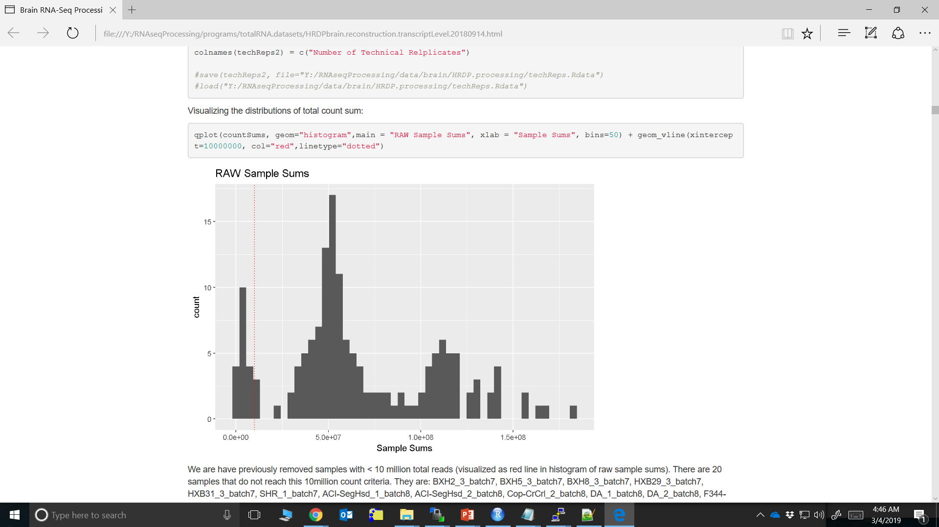
Visualizing Data – Library Sizes
ggplot2 is a great tool
Sample-level QC
In this example I had 158 samples, so it was difficult to look at a table of library sizes

Slide 8
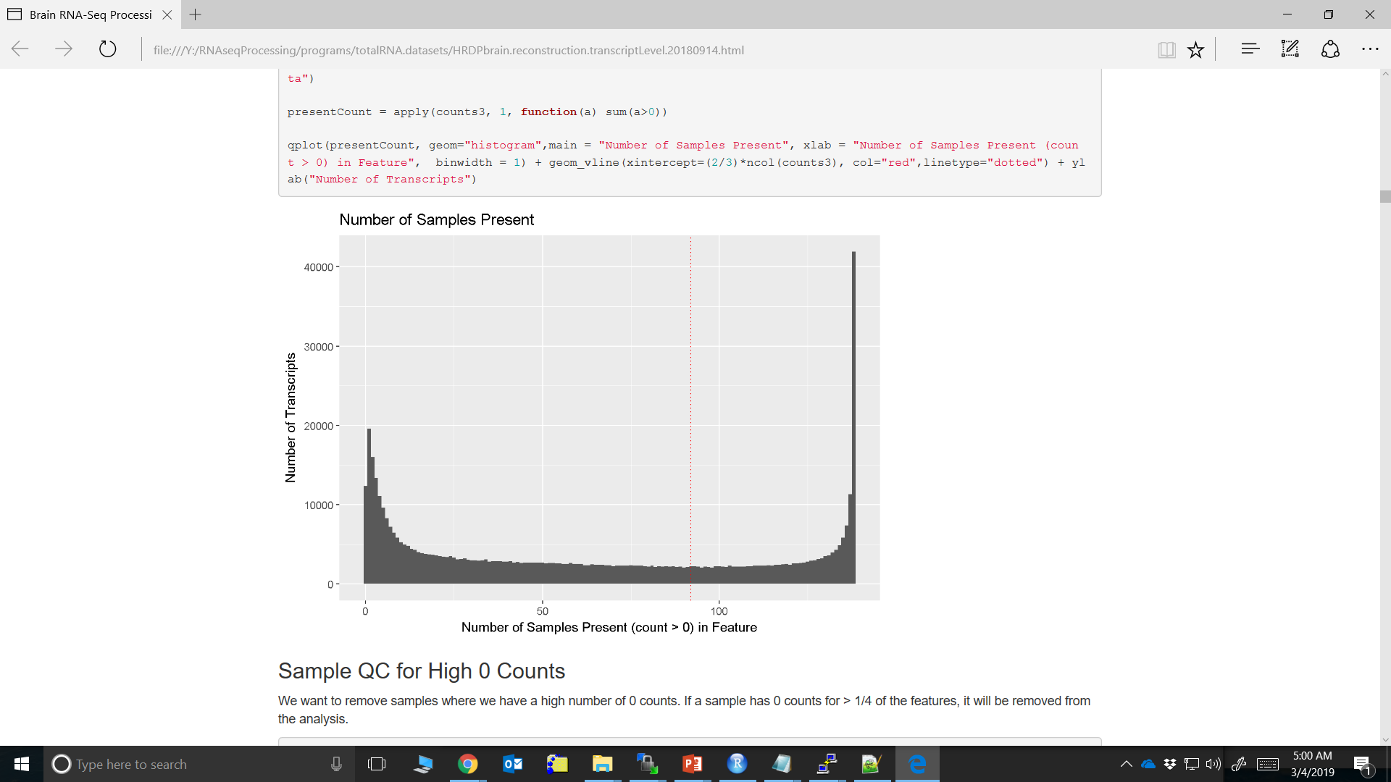
Visualizing Data – Number of 0 Counts
Feature-level QC
At the VERY least, you want to remove genes (isoforms) from you dataset that have 0 counts across ALL samples
Detection Above BackGround (DABG)
Debated topic

Slide 9
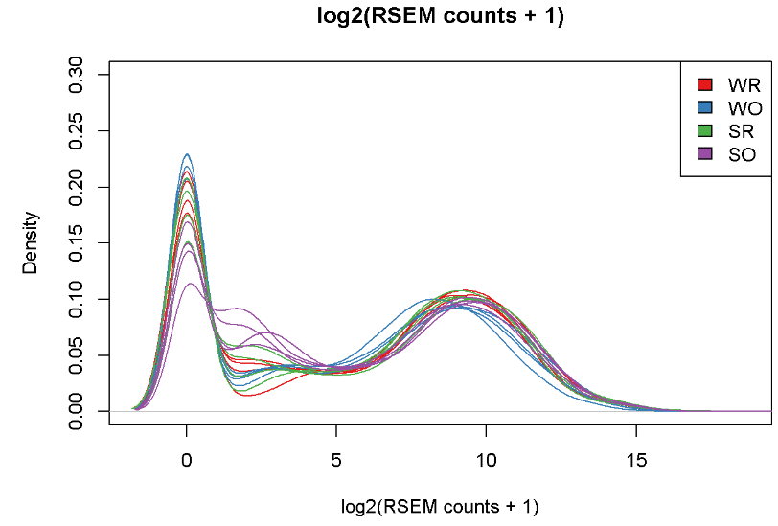
Visualizing Data- Density Plots Example 1
Density plot for each individual sample
Colored by group
Big Spike around 0
DABG 0 counts in all samples
Larger hump later on

Slide 10
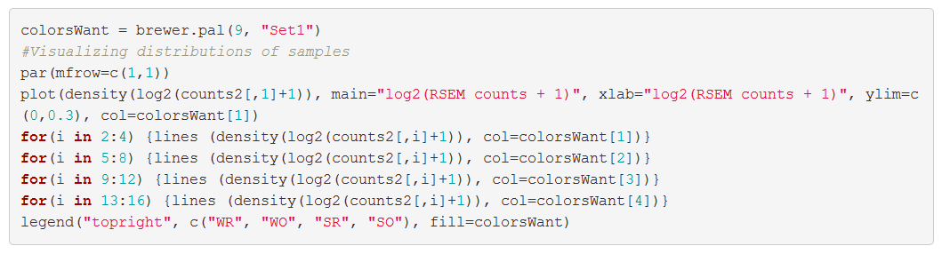
Visualizing Data- Density Plots Example 1 Code
library(RColorBrewer)

Slide 11
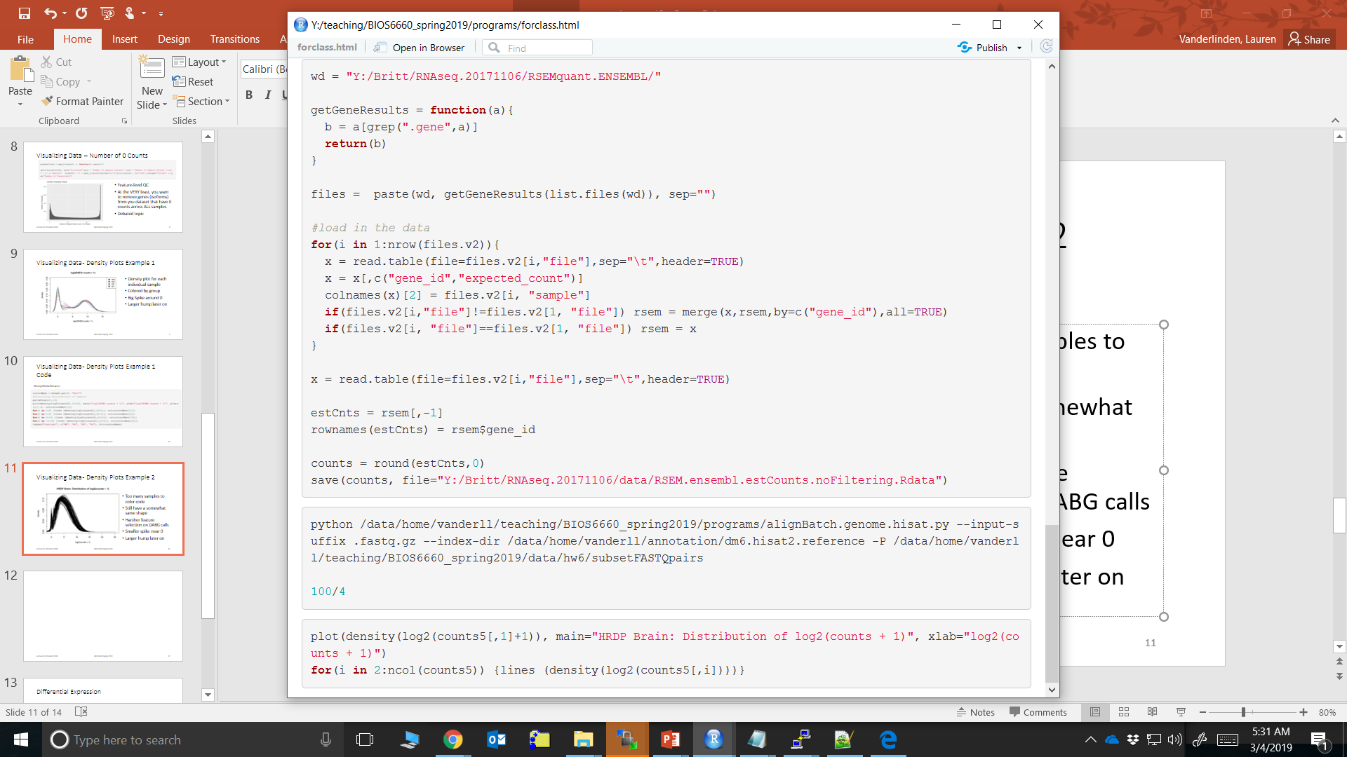
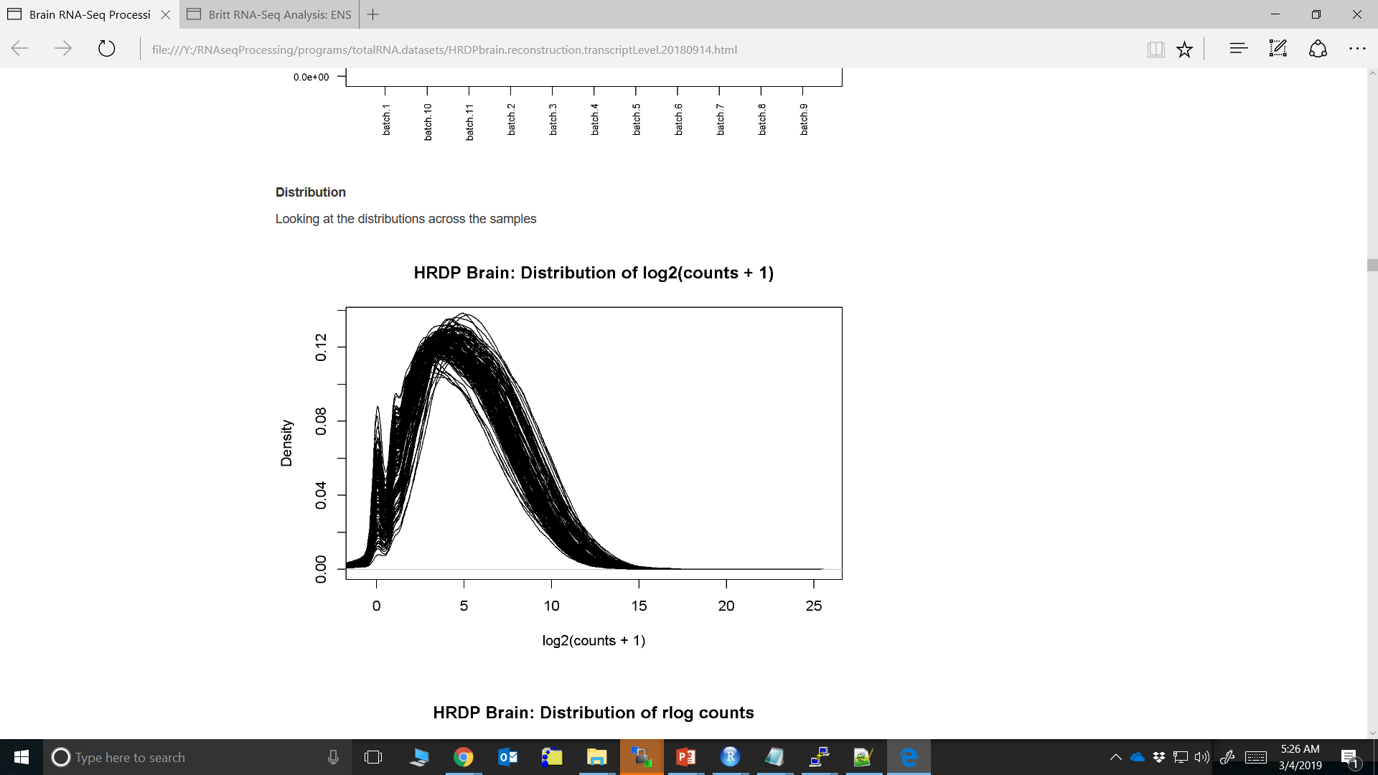
Visualizing Data- Density Plots Example 2
Still have a somewhat same shape
Harsher feature selection on DABG calls
Smaller spike near 0
Larger hump later on

Slide 12
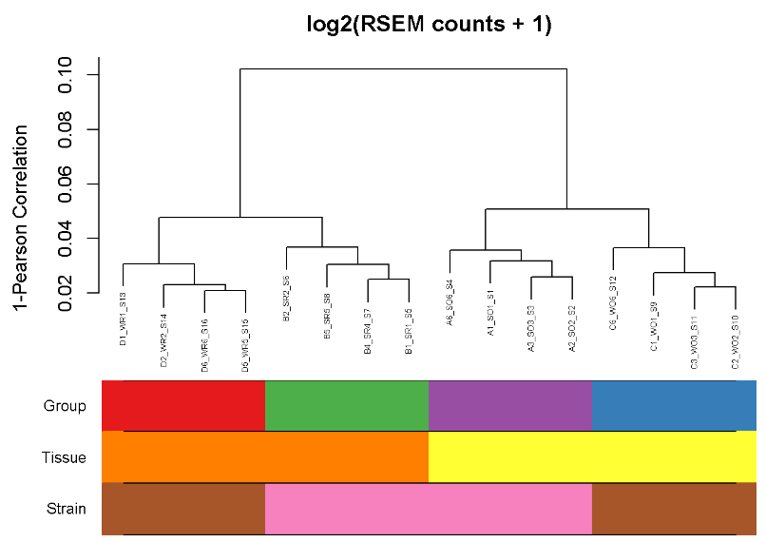
Visualizing Data – Dendrogram Example 1
y-axis is the distance (or dissimilarity)
1-correlation
Clustering by group really well
This is an animal model
Tissue explains the main distance
First break at 0.1
Strain explains the second most distance
Second breaks around 0.05
Great tool for experiments with small number samples

Slide 13
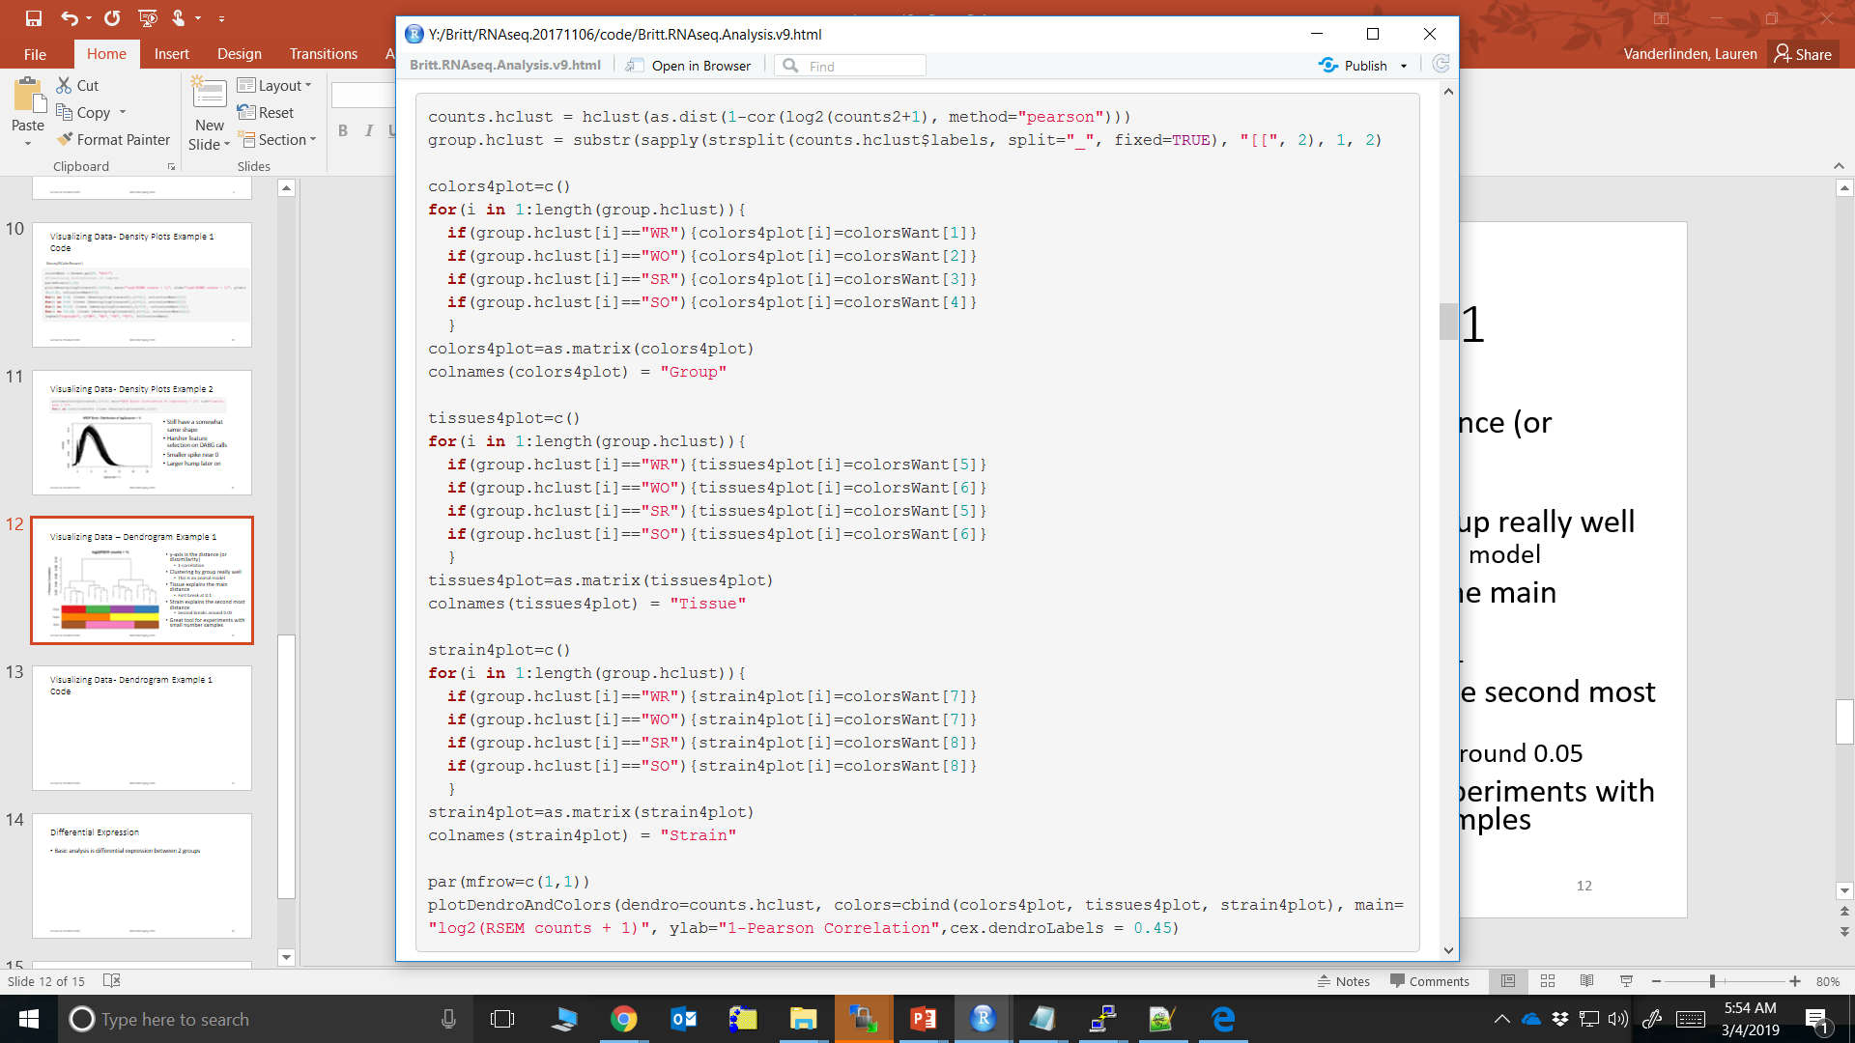
Visualizing Data- Dendrogram Example 1 Code
library(WGCNA)
Sample name format: A1_SO1_S1
…

Slide 14
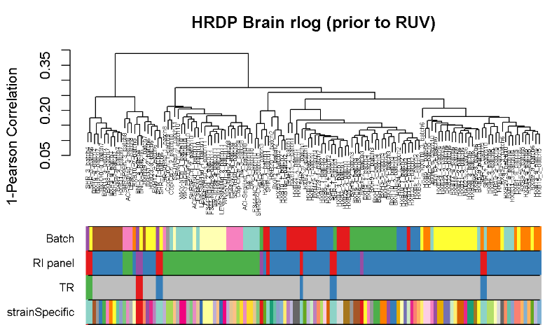
Visualizing Data – Dendrogram Example 2
Take away from this is there are some major batch effects we need to deal with
Good to identify sample outliers
Hard to actually see grouping with some many samples

Slide 15
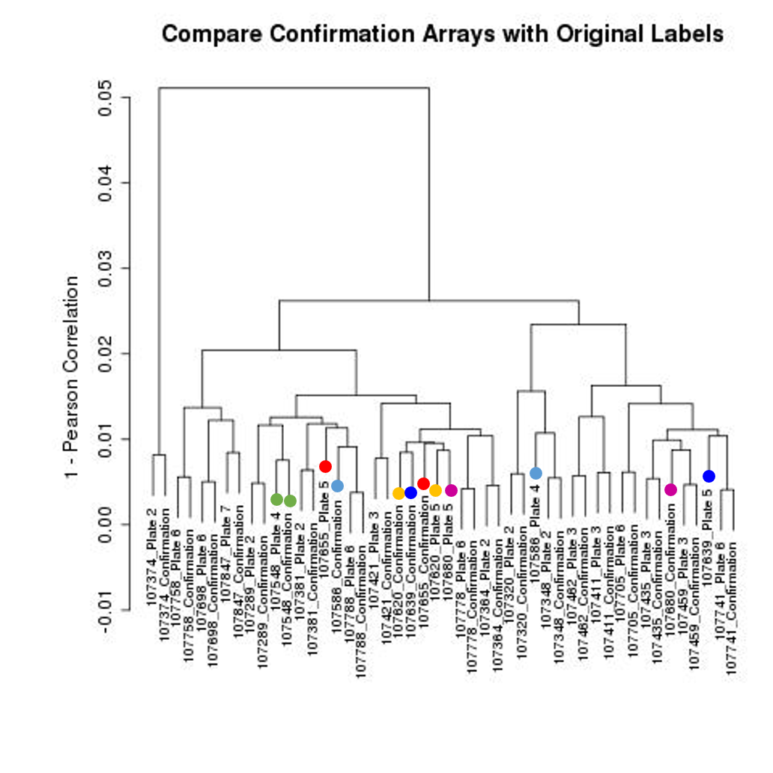
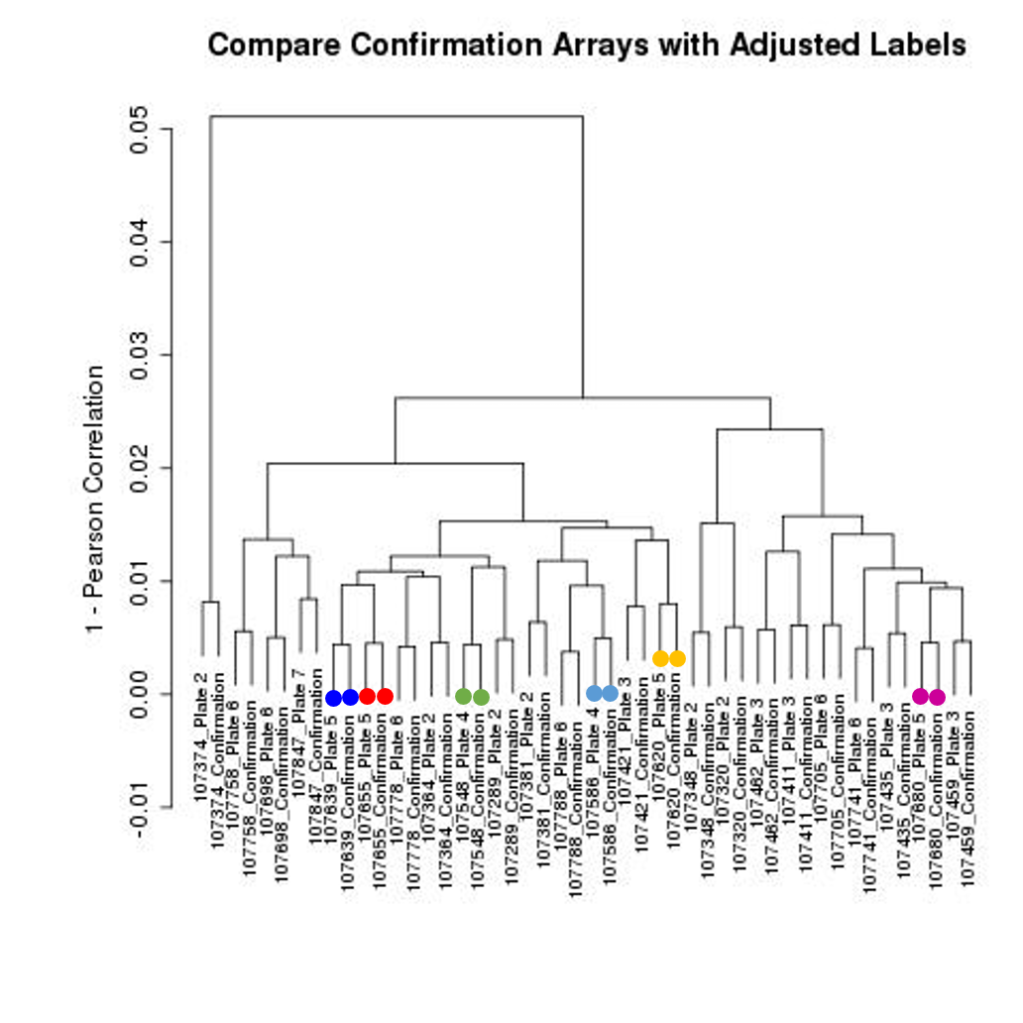
Visualizing Data – Dendrogram Example 3

Slide 16
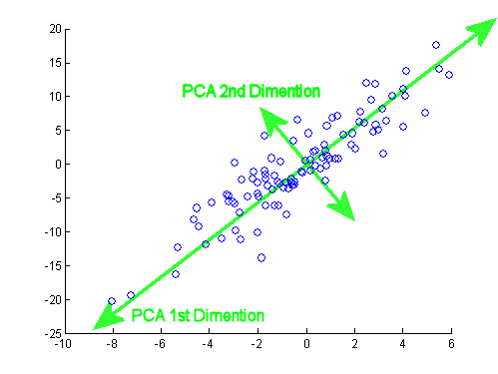
Principal Component Analysis (PCA)
Good way to summarize your data
Linear combinations of data which explain the most variance
PC1 explains the most variance in your data, PC2 the second most
Easy example with 2D space, what about 20K dimensions!
Source: stackExchange: making-sense-of-principal-component-analysis-eigenvectors-eigenvalues

Slide 17
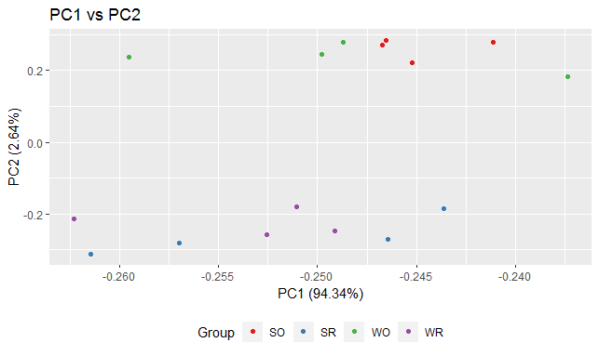
Visualizing Data – PC Plots Example 1
# points = # samples
This is the same data from the 16 sample dendrogram
Large separation from tissue type on PC2
For a homogeneous design (controlled genetic background), you do see a large % variance explained by PC1

Slide 18
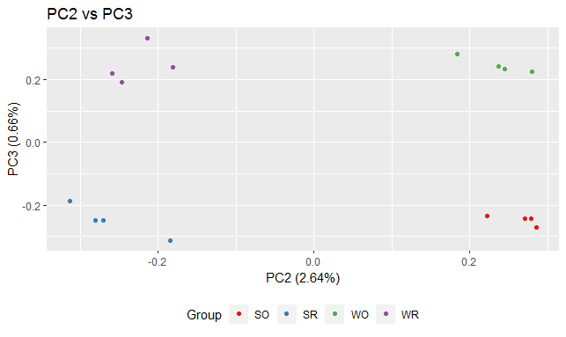
Visualizing Data – PC Plots Example 1 Cont.
Here you are seeing great separation of groups.
You normally don’t see this on PC1
PC2 describes tissue differences (the 2nd letter in group)
PC3 describes the strain differences (the 1st letter in group)

Slide 19
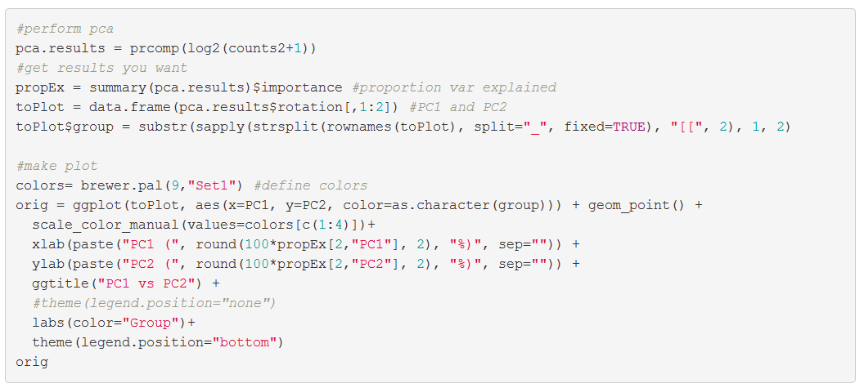
Visualizing Data – PC Plots Example1 Code
library(ggplot2)
library(RColorBrewer)

Slide 20
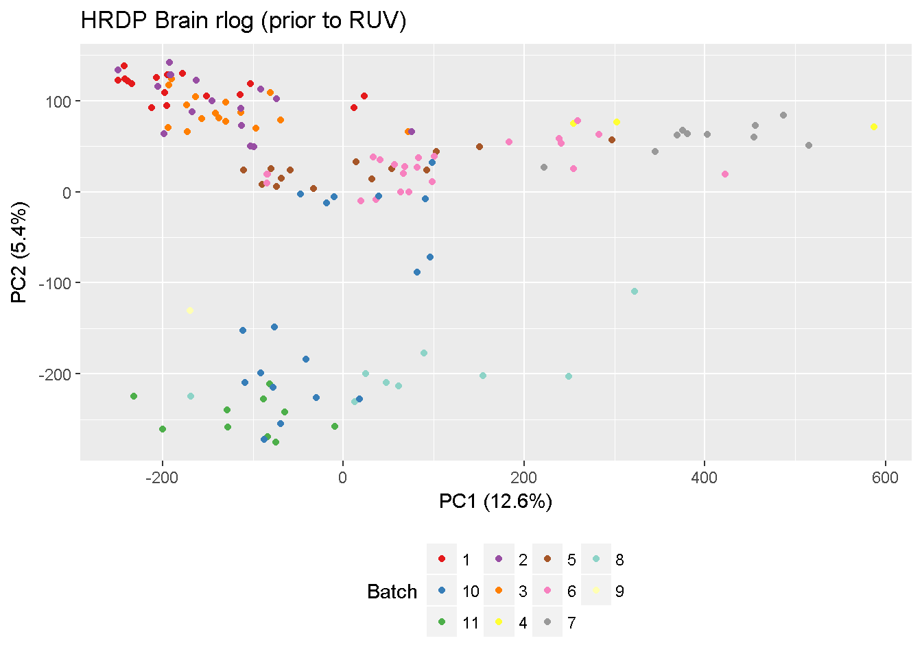
Visualizing Data – PC Plots Example 2
Lot more samples
Batch effects are clearly an issue
PC1 explains lower % variance
Find this is the case the more complex the study design

Slide 21
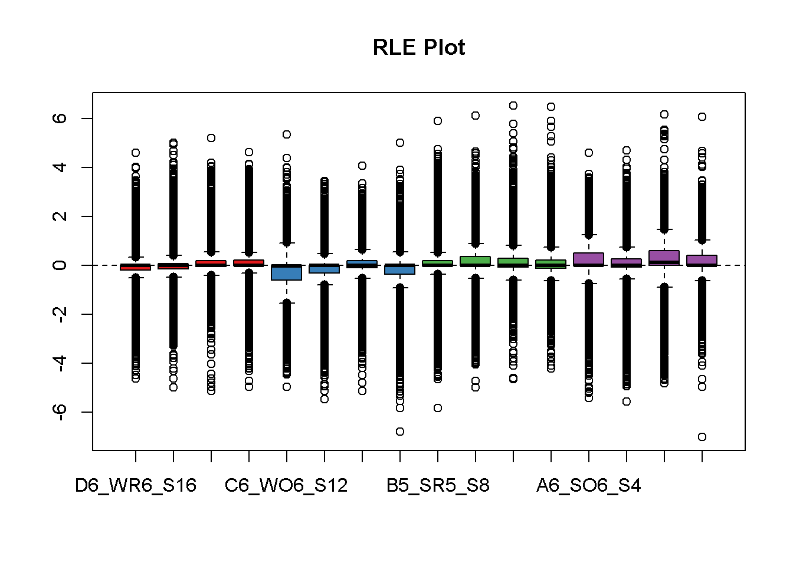
Visualizing Data – RLE Plots
Relative Log Expression
For each gene, calculation the median logged expression
These boxplots are the differences from the median value
Originally looked at for microarrays, but the theory still stands
Want the median RLE near 0
ASSUMING # up-regulated genes = # down-regulated genes
Majority of genes DO NOT CHANGE in the system you are questioning

Slide 22
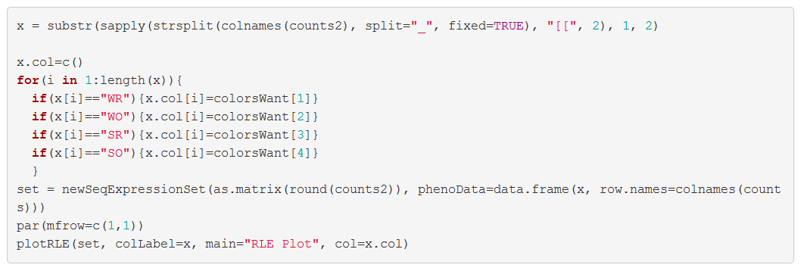
Visualizing Data – RLE Plot Code
library(EDASeq)
library(RColorBrewer)

Slide 23
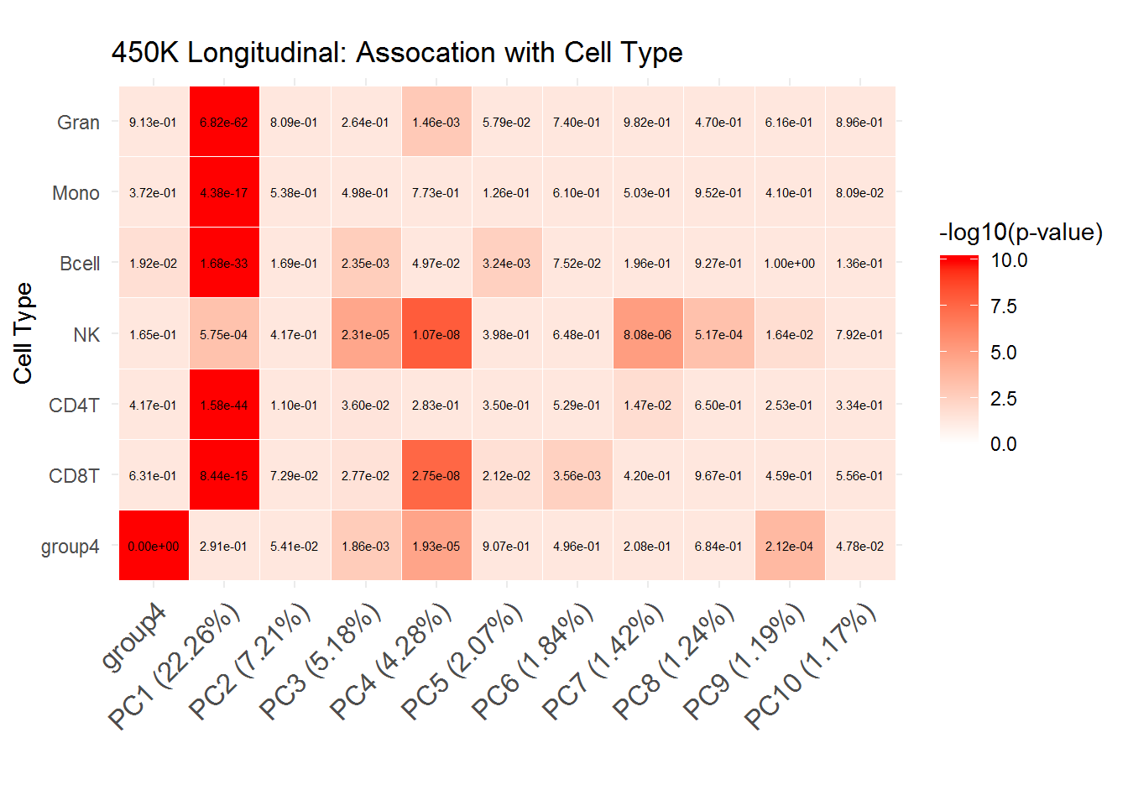
Visualizing Data – Diagnostic Heatmap

Slide 24
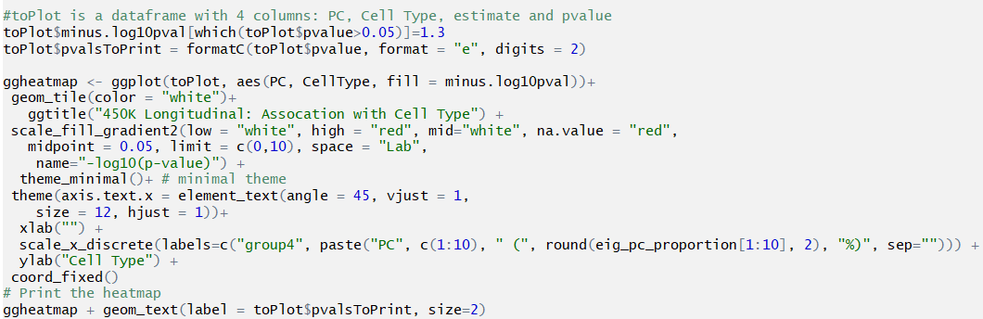
Visualizing Data – Diagnostic Heatmap Code

Slide 25
Relative Abundance
RNA-Seq is a relative abundance measurement technology
Gene | Sample 1 Absolute Abundance | Sample 1 Relative Abundance | Sample 2 Absolute Abundance | Sample 2 Relative Abundance
A | 20 | 10% | 20 | 5%
B | 20 | 10% | 20 | 5%
C | 20 | 10% | 20 | 5%
D | 20 | 10% | 20 | 5%
E | 20 | 10% | 20 | 5%
F | 100 | 50% | 300 | 75%
 | TOTAL 200 counts |  | TOTAL 400 counts
Library Sizes Matter

Slide 26
Normalization Methods
Need to do this to make samples comparable across features and samples
Common Methods:
RPKM/FPKM
TPM
Quantile
TMM (EDASeq)
DESeq Median of Ratios (geometric mean & scaling factor)
RUV

Slide 27
RPKM/FPKM
Reads Per Kilobase per Million or Fragments PKM
One of the 1st normalization methods
Adjusts for
Sequencing depth (or library size)
Length of gene (longer gene more reads)
Count up total number reads in sample and divide by a million (per million scaling factor)
Divide read counts by “per million” scaling factor. Normalizing for sequencing depth (RPM, reads per million)
Divide RPM by length of gene in Kb, this give you RPKM
FPKM is for paired-end reads, really so the 2 reads from a single fragment of RNA is not counted twice.

Slide 28
TPM
Transcripts Per Million
Very similar to RPKM/FPKM but order of operations are switched
Adjusts for length of gene first, then sequencing depth
Divide counts by length of gene in Kb (RPK)
Count up all the RPK values in a sample and divide this number by 1 million (this is the per million scalilng factor).
Divide the RPK values by “per million” scaling factor, this gives you TPM.
Preferred over RPKM/FPKM since using TPM the total sum of gene TPM will be the same across all samples (i.e. really have the same denominator)
RSEM outputs TPM

Slide 29
RPKM vs TPM example
RPKM Matrix
Gene | Rep 1 | Rep 2 | Rep 3
A (2kb) | 1.43 | 1.33 | 1.42
B (4kb) | 1.43 | 1.39 | 1.42
C (1kb) | 1.43 | 1.78 | 1.42
D (10kb) | 0 | 0 | 0.009
TOTAL | 4.29 | 4.5 | 4.269
Counts Matrix
Gene | Rep 1 | Rep 2 | Rep 3
A (2kb) | 10 | 12 | 30
B (4kb) | 20 | 25 | 60
C (1kb) | 5 | 8 | 15
D (10kb) | 0 | 0 | 1
TOTAL | 35 | 45 | 106
TPM Matrix
Gene | Rep 1 | Rep 2 | Rep 3
A (2kb) | 3.33 | 2.96 | 3.326
B (4kb) | 3.33 | 3.09 | 3.326
C (1kb) | 3.33 | 3.95 | 3.326
D (10kb) | 0 | 0 | 0.02
TOTAL | 10 | 10 | 10
Note: In this sample I used per 10 instead of per 1 million just to make the numbers easier to look at
Source: RNASeq blog
Your total is the sample across samples, so it’s easier to compare across samples

Slide 30
Quantile Normalization
Making your distributions identical in statistical properties (i.e. the quantiles will be the same)
Ranking the genes for each sample
Get a rank expression level then each rank gets a new expression level
Rank | Sample 1 | Sample 2 | …. | Sample N | Normalized Value
1 | 0 | 1 | … | 0 | Mean 1st row
2 | 3 | 2 | … | 2 | Mean 2nd row
… | … | … | …. | …. | …
G | 10002 | 9999 | … | 9232 | Mean Gth row

Slide 31
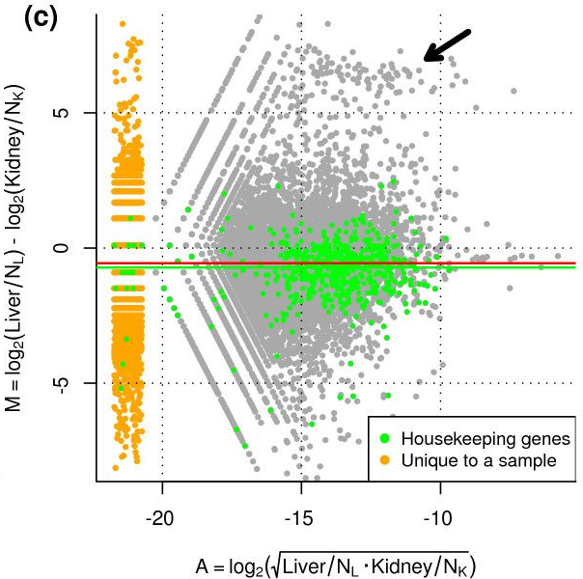
TMM (EDASeq)
Weighted Trimmed Mean of Log Expression Ratios (M values)
Very similar to a Bland-Altman plot
Call A (x-axis) the reference sample (geometric mean of 2 samples)
Red line should be at 0
Where the line is the normalization factor
Source: Robinson et al, 2010

Slide 32
DESeq Median of Ratios
Normalized Count = count / geometric mean of that gene
Within sample normalization factor by taking the median across all genes.
Sample 1 normalization factor = median(c(1.41, 1.17)) = 1.29
Sample 2 normalization factor = median(c(0.71, 0.86)) = 0.785
3. Final Normalized Matrix
Gene | Sample 1 | Sample 2 | Geometric Mean
A | 100 | 50 | 70.7
B | 300 | 220 | 256.9
Gene | Sample 1 | Sample 2
A | 1.41 | 0.71
B | 1.17 | 0.86
Gene | Sample 1 | Sample 2
A | 100/1.29 = 77.5 | 50/0.785 = 63.7
B | 300/1.29 = 232.6 | 220/0.785 =280.3

Slide 33
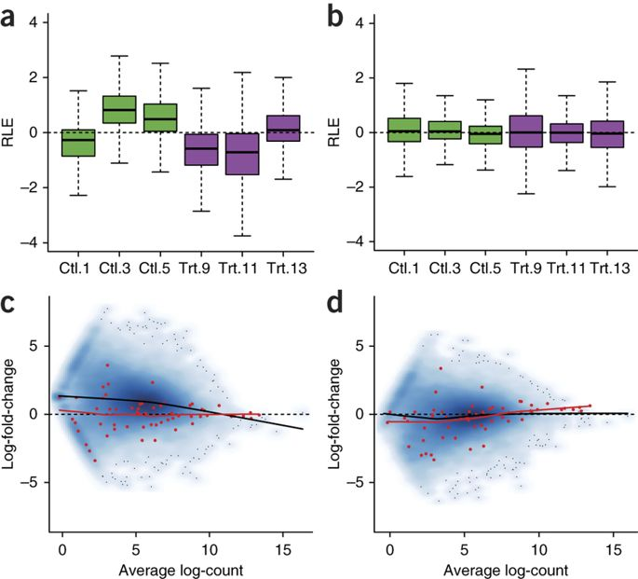
RUV
Remove Unwanted Variation
Idea is to use control genes that do not change in your design
Spike-ins
Biological knowledge
Empirical Method
Uses factor analysis (very similar to PCA)
Depending on how many control genes you have, you can adjust out for as many factors (k)
Source: Risso et al, 2014

Slide 34
Normalization Methods Summary
DO NOT USE RPKM/FPKM
Preferably keep data as count data and use either DESeq or EDASeq
These packages allow you to analyze the data using a GLM with assumption data is distributed with NB distribution
However, they don’t allow you to have any random effects
RUV is a newer exciting method
Selecting number factors to adjust out (k) is not straight forward
Many times used in conjunction with others

Slide 35
Differential Expression
Basic analysis to find differences in expression between a group(s).
Common Analysis Techniques:
T-test
ANOVA
Linear Regression
Linear Mixed-Effect Models
Generalized Linear Models (GLM)
Link function so you can run data that is non-normal in a linear model structure
DESeq & EDASeq
Normally Distributed Data
(TPM and/or transformation)

Slide 36
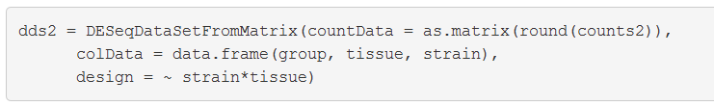
DESeqDataSet Format
S4 Type of object
Stores the input values (raw counts), intermediate calculations (any normalization) and results of an analysis of differential expression (from DESeq or DESeq2)
If you used HTSeq (python module) to generate counts, you can use DESeqDataSetFromHTSeqCount() to generate object

Slide 37
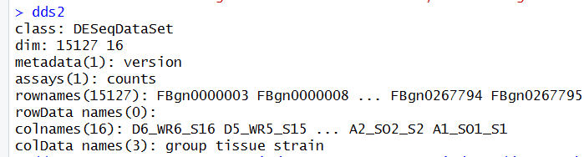
DESeqDataSet Format
rawCountMatrix <- counts(dds2)
metaData <- colData(dds2)

Slide 38
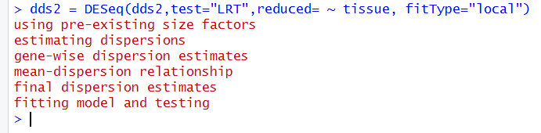
DESeq2 Analysis - LRT example
#performs median of ratios normalization
dds2 = estimateSizeFactors(dds2)
#if you want to extract normalized count matrix
normalizedCounts = counts(dds2, normalized=TRUE)
#perform a likelihood ratio test (LRT) to see any strain effect

Slide 39
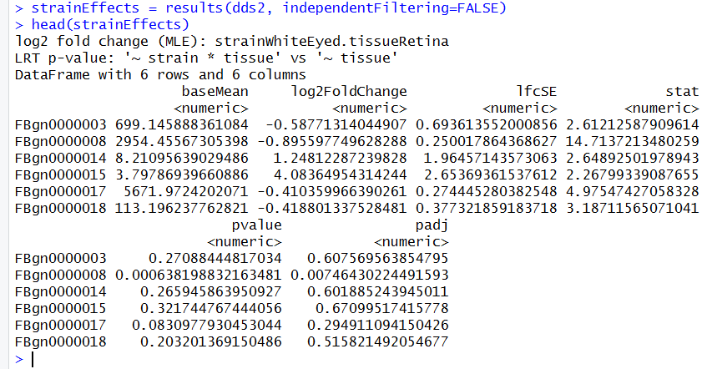
DESeq2 Analysis – LRT example

Slide 40
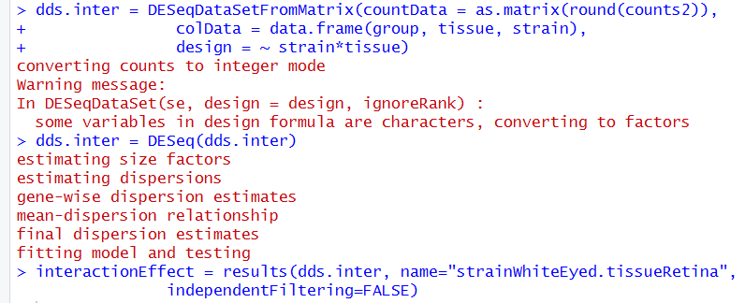
DESeq2 Analysis – single coefficient example

Slide 41
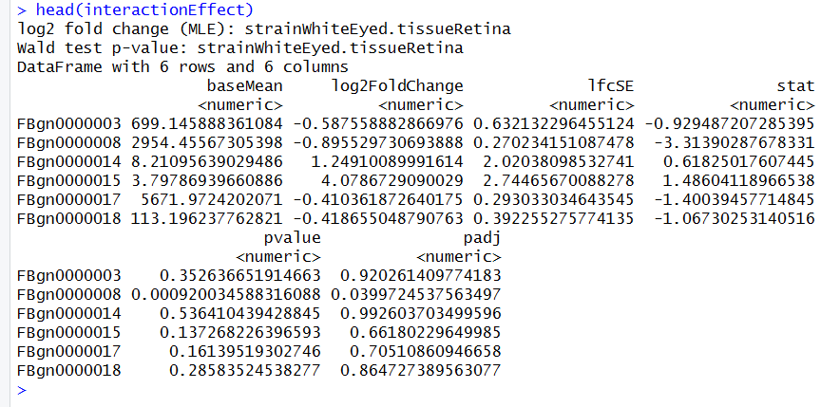
DESeq2 Analysis – single coefficient example

Slide 42
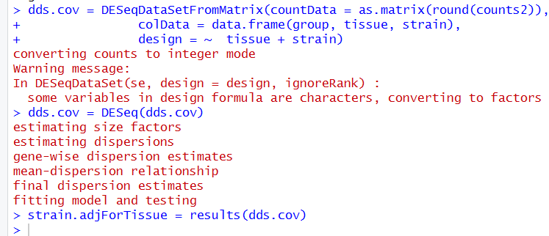
DESeq2 Analysis – Adjusting for Covariate

Slide 43
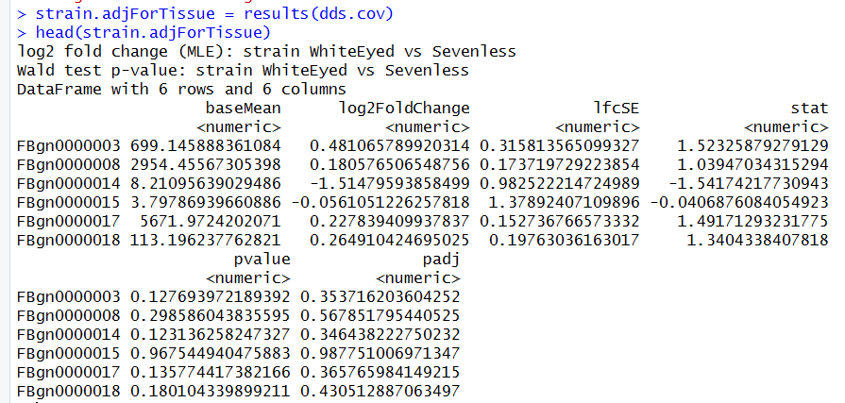
DESeq2 Analysis – Adjusting for Covariate
results() has a name option for selecting coefficient, but default it automatically returns last coefficient in model

Slide 44
References
Robinson MD, Oshlack A. A scaling normalization method for differential expression analysis of RNA-seq data. Genome Biol. 2010;11(3):R25.
Anders S, Huber W. Differential expression analysis for sequence count data. Genome Biol. 2010;11(10):R106.
Risso D, Ngai J, Speed T, Dudoit S (2014). “Normalization of RNA-seq data using factor analysis of control genes or samples.” Nature Biotechnology, 32(9), 896–902.

